Slide 1

SMART FARMING HACKATHON - 2025
Smart Farming
TEAM:BRIGHT MIND
01

Slide 2
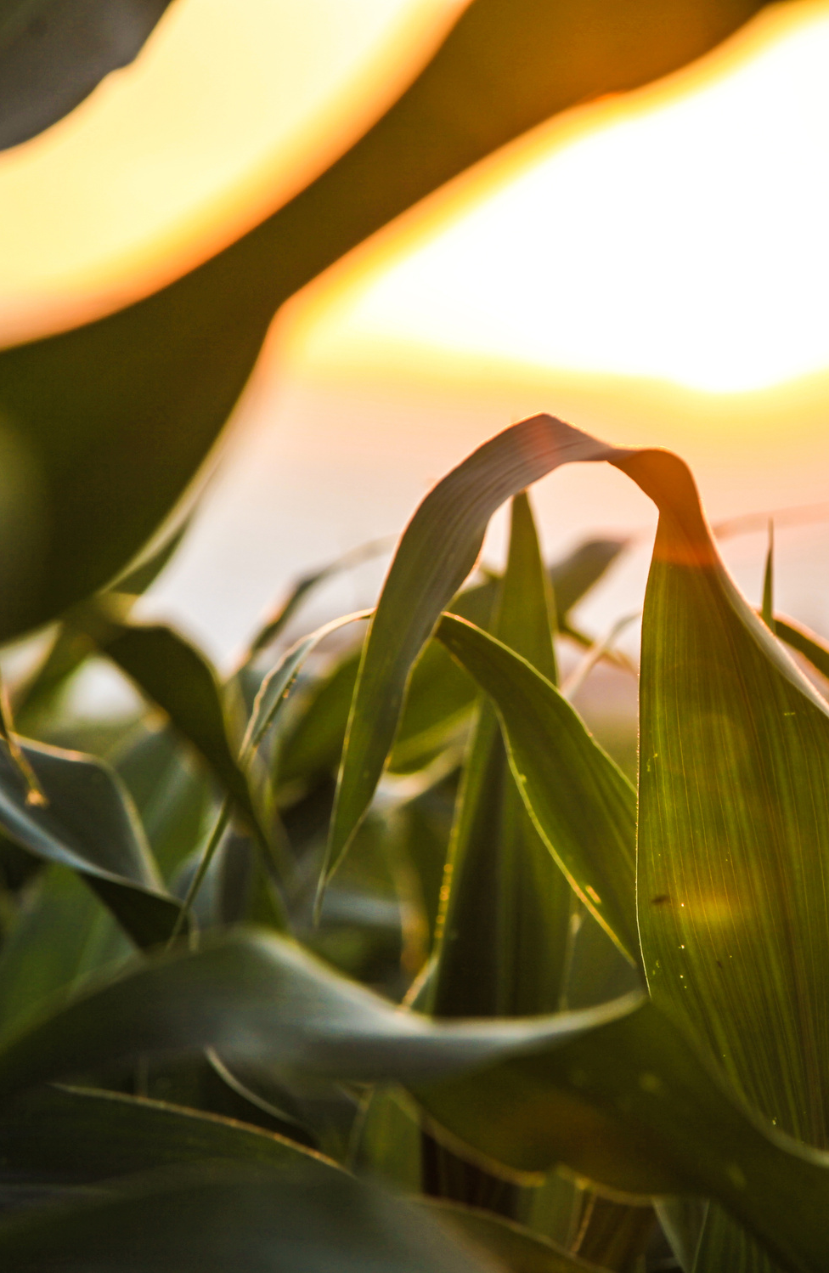
SMART FARMING HACKATHON - 2025
Team Members:
Burak Aydin
Suzan Aydin
Jonathen Günther
Prithikalakshmi Boopalan
Jan Müller
02
02

Slide 3
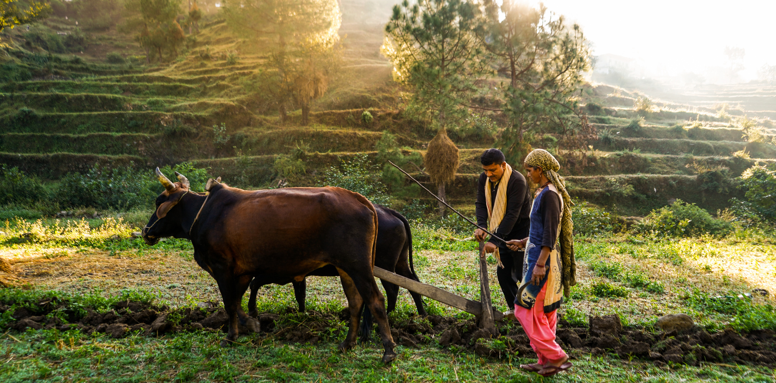
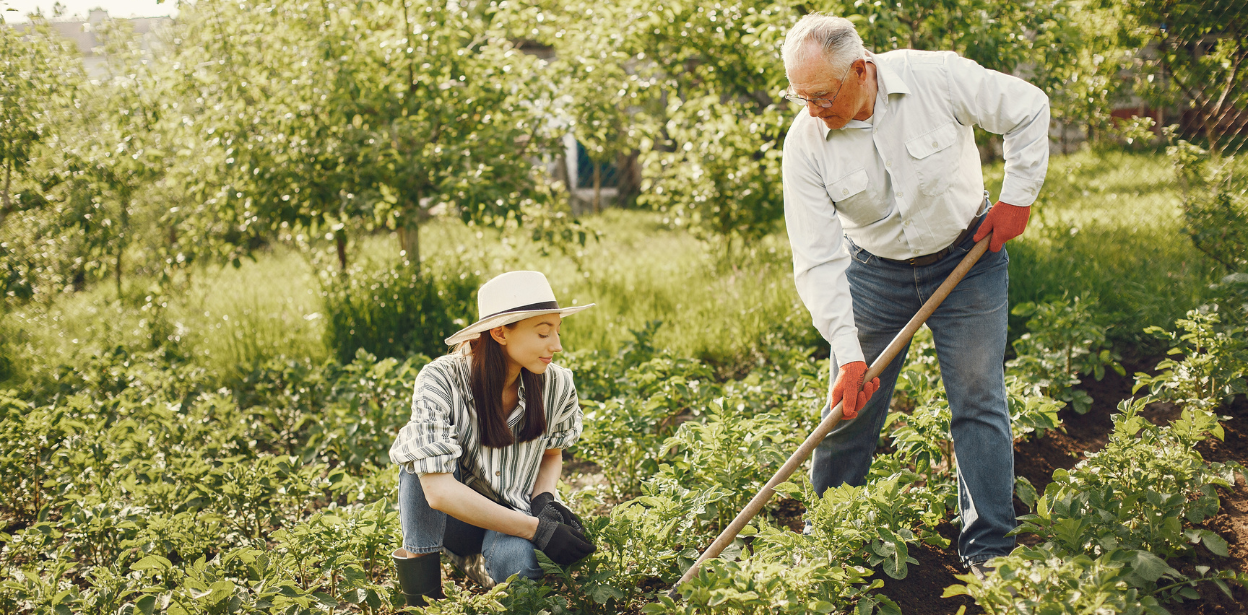
SMART FARMING HACKATHON - 2025
Use Case 2:Continuous fertilizer requirement determination including distances
Fertilizer requirements must be determined individually and in a legally compliant manner based on legal requirements, land characteristics, and operational crop planning. Currently, access to public Geodata is technically and legally fragmented, which hinders digitization
PROBLEM
STATEMENT
SOLUTION
To provide accurate regulation automation across the globe, Farming Management Information Systems (FIMS) should make their own integration for local regulation makers. With our solution, we provide a way to the industry to implement standardized regulations and integrate it to all the Farming Management Information's Systems.
03

Slide 4
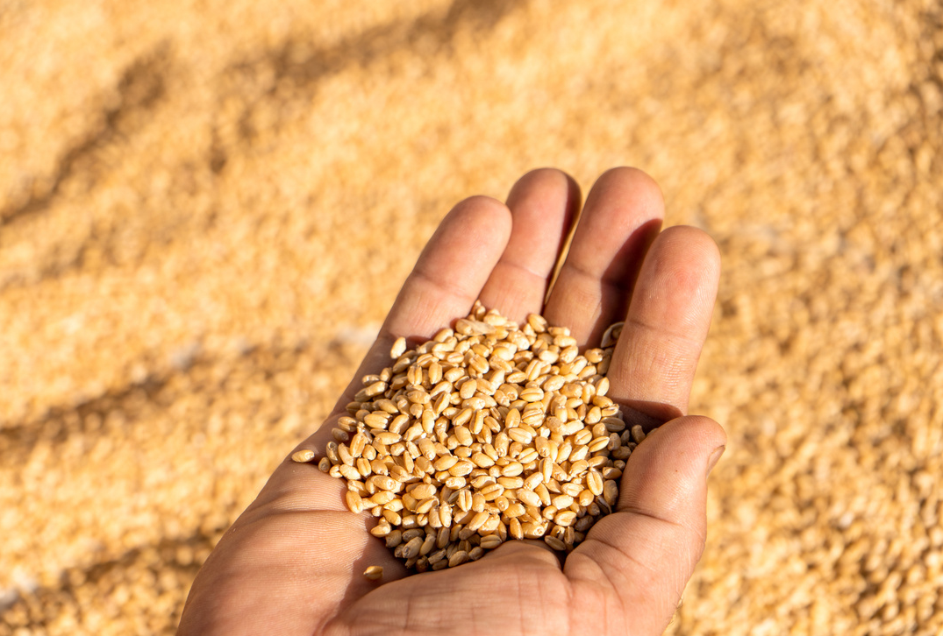
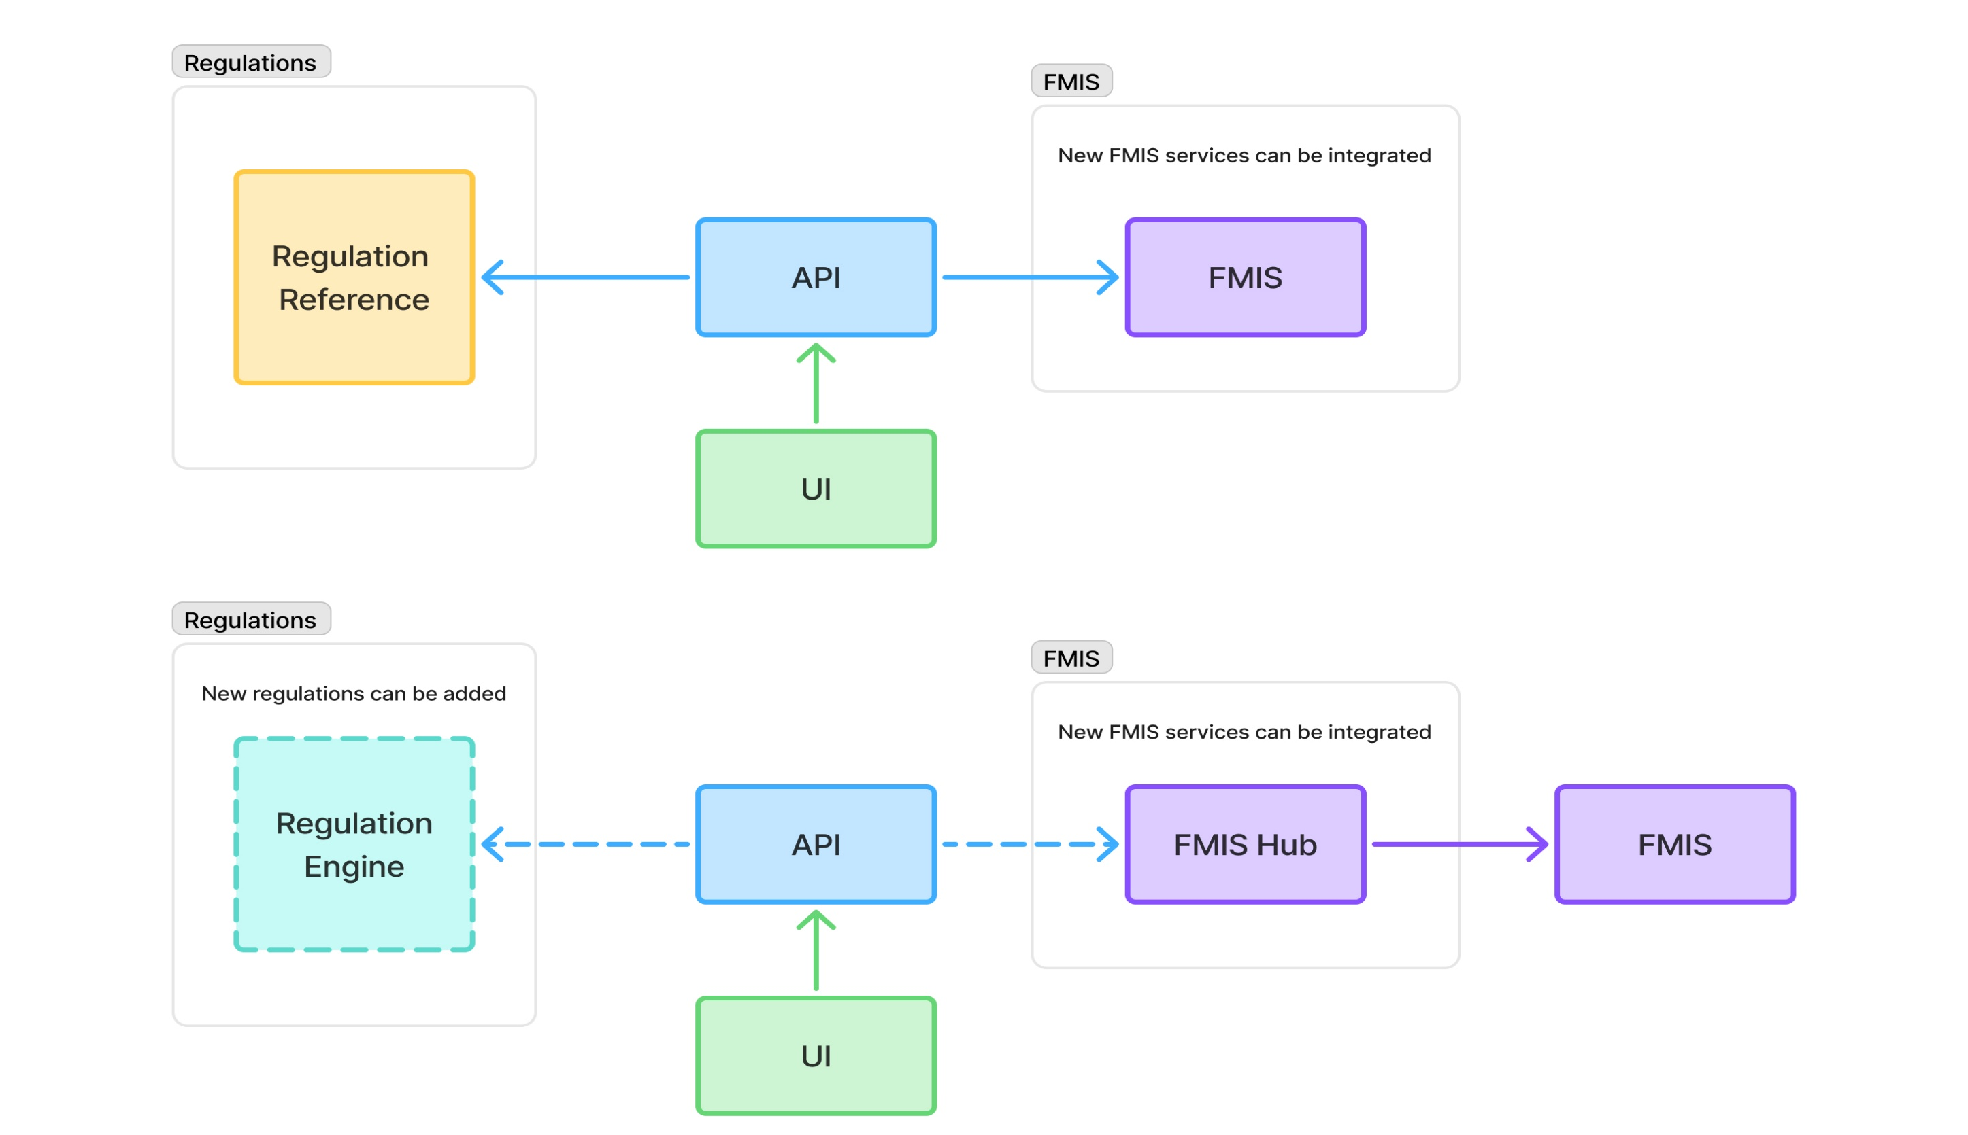
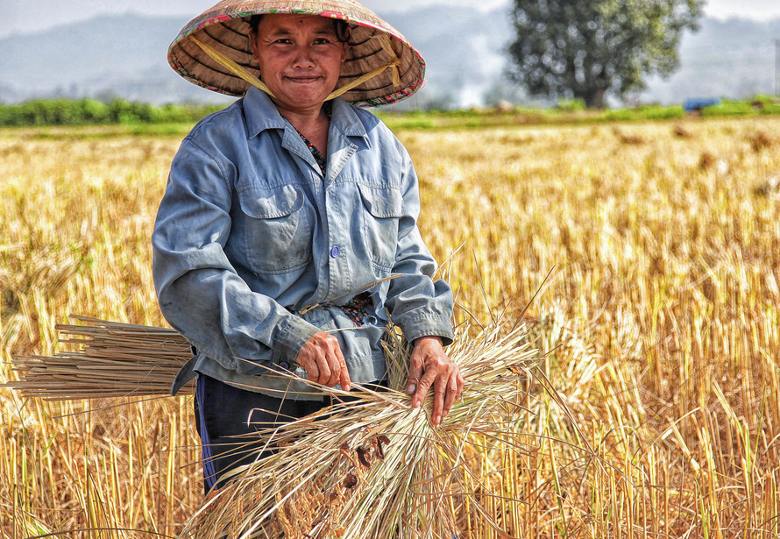
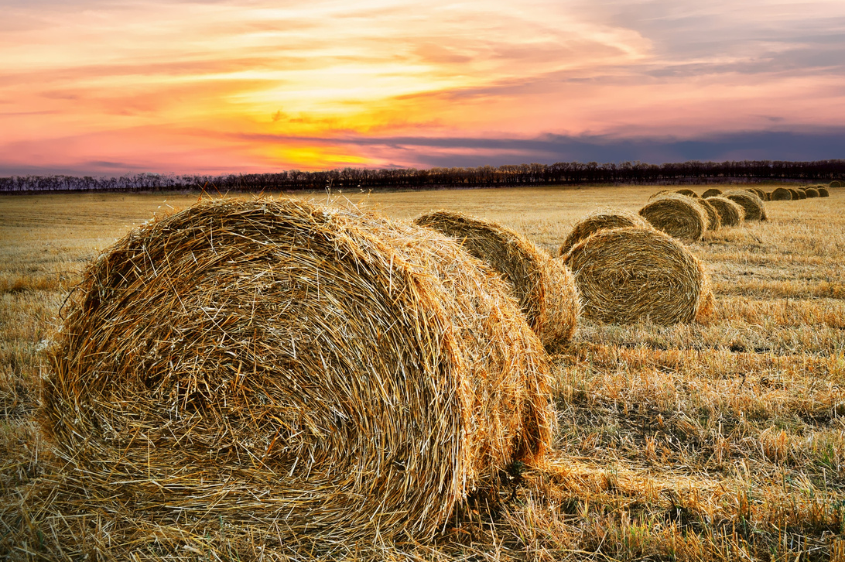
SMART FARMING HACKATHON - 2025
Process Architecture
04

Slide 5
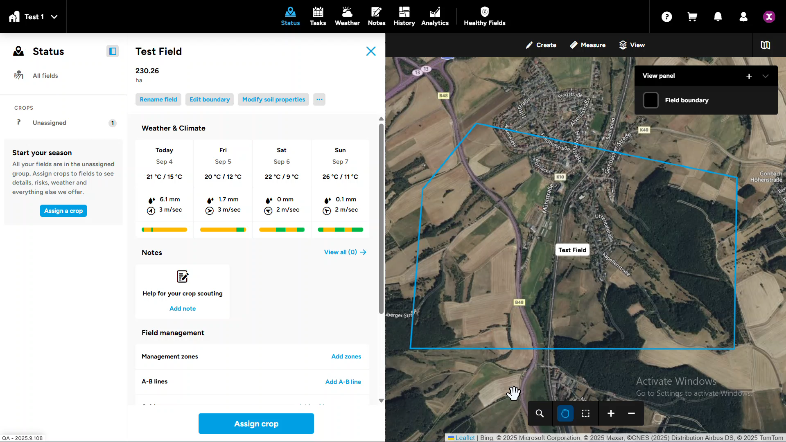
SMART FARMING HACKATHON - 2025
Demo
05

Slide 6
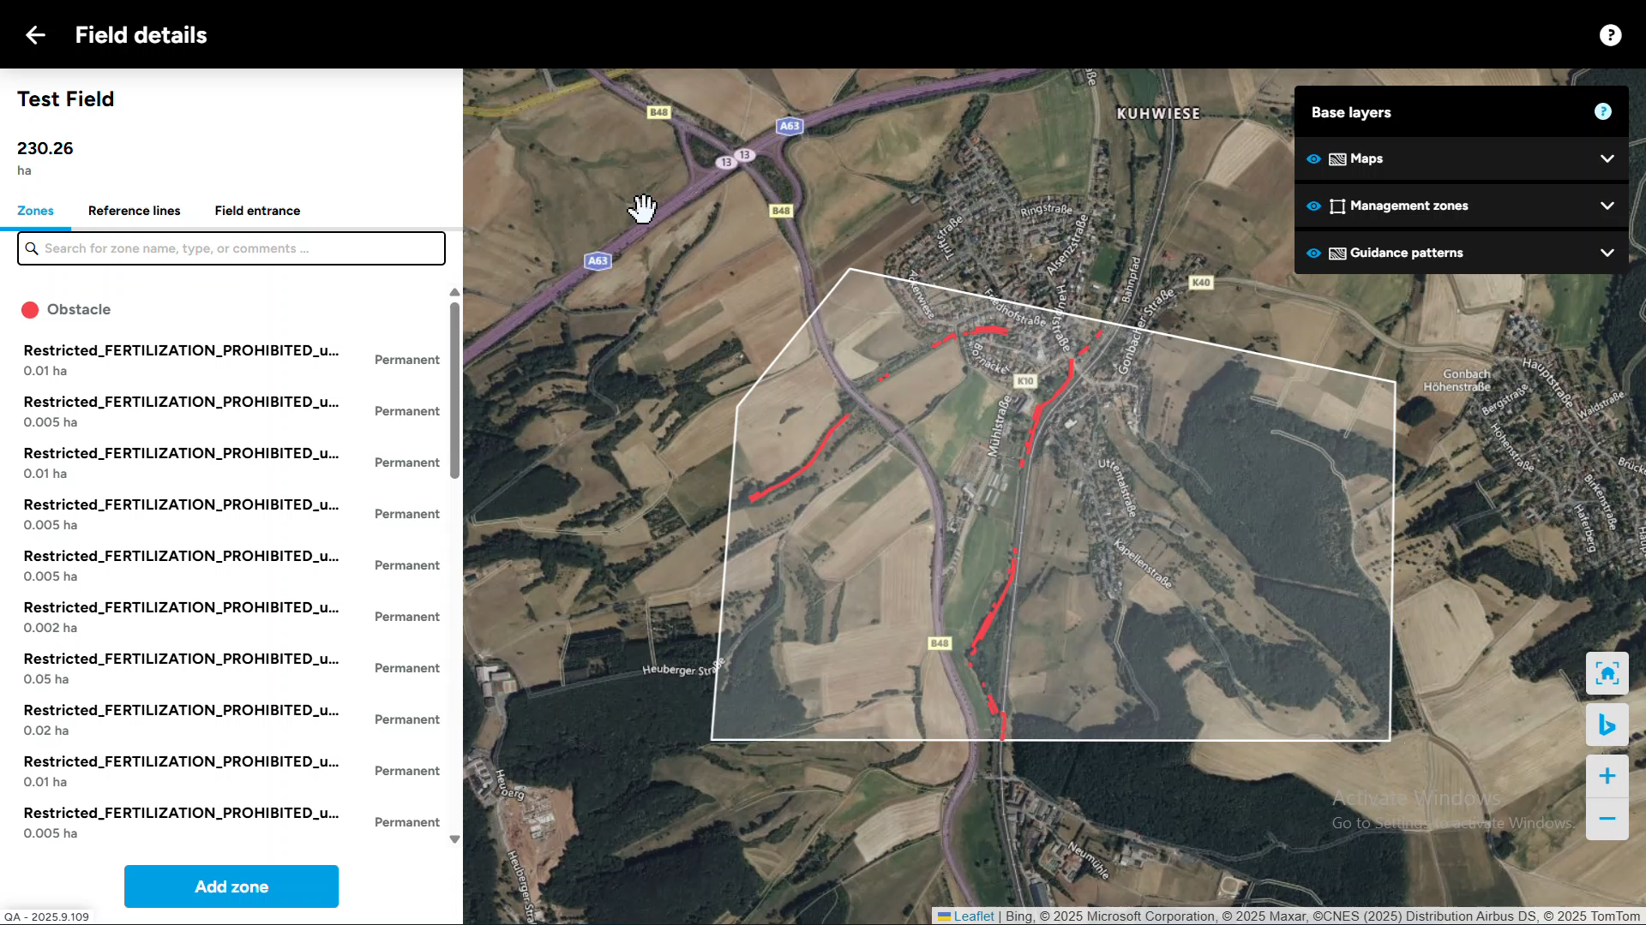
SMART FARMING HACKATHON - 2025
Demo
06

Slide 7
SMART FARMING HACKATHON - 2025
Thank You
07

